Slide 1
Lesson 1
Acronyms and Terminology

Slide 2
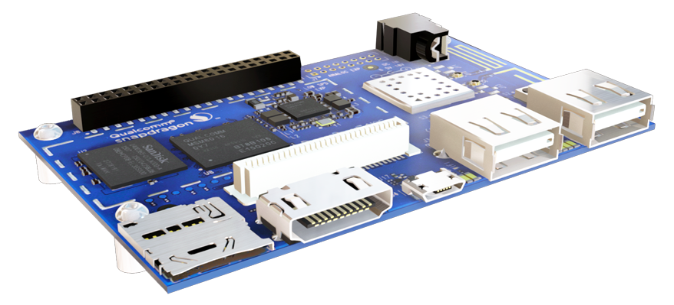
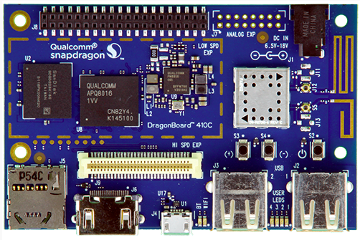
Lesson 1 | Acronyms and Terminology
1 - Acronyms
2 - Terminology

Slide 3
BREAK
Q:?
a).
b).
c).
d).
e).

Slide 4
1 - Acronyms

Slide 5
1 | Acronyms
CV - Computer Vision: concept of processing and analyzing images to make decisions or obtain some kind of data
NDK - Native Development Kit: the Android SDK for creating applications in C/C++ (normally, Android applications are in Java)
AAC - Advanced Audio Coding: Audio coding standard for lossy digital studio compression
DVI - Digital Visual Interface: Video display interface developed by Digital Display Working Group (DDWG).
DVS - Descriptive Video Service: Major United States producer of video description, feature films and home videos, more accessible to people who are blind or otherwise visually impaired.

Slide 6
1 | Acronyms
IM - Instant Messaging: System for exchanging typed electronic messages instantly via the Internet or cellular network.
MHP - Multimedia Home Platform: Digital video broadcasting (DVB) with the internet and the World Wide Web.
MIDI - Musical Instrument Digital Interface: Protocol designed for recording and playback music on digital synthesizers that is supported by many makes of personal computer sound cards
RAM - Real Audio Media: May refer to analog tape cassettes and digital CDs as well as to computer files containing audio in any number of digital formats.
VT - Video Telephony: Full-duplex, real-time audio-visual communication between or among end users

Slide 7
1 | Acronyms
DSP Solution - Digital Signal Processing Solution: Collect, process, compress, transmit, and display the analogue and digital data found in today’s most popular multimedia applications.
SSE - Streaming SIMD Extensions: Intel’s SSE and SSE2 tech are effectively sets of instructions for accelerating multimedia applications.
sRGB - Standard Red, Green, Blue: The colour space standard established by the International Electrotechnical Commission which forms the basis of colour matching hardware devices such as CRT monitors, LCD panels, projectors, printers, scanners, and digital cameras and applications, including the World Wide Web.

Slide 8
BREAK
Q:?
a).
b).
c).
d).
e).

Slide 9
2 - Terminology

Slide 10
2 | Terminology
Multimedia: Audio/Video, refers to the delivery of information that combines different content formats (motion video, audio, still images, graphics, animation, text, etc…)
Library: A collection of resources used to develop software
Scalability (Applications): Refers to how an application (or anything) can be increased in size (e.g. will a website be able to handle all this traffic?)
Maintainability: How difficult will an application, or something of the like, be to maintain; adding features, fixing issues, relates to scalability
Subsampling: Bandwidth reduction techniques which reduce the amount of digital data used to represent an image. Part of a compression process.

Slide 11
2 | Terminology
Scalability: The ability to vary the information content of a program by changing the amount of data that is stored, transmitted or displayed.
QuickTime: Apple Computer’s video environment. QuickTime video files must be converted to .AVI format to run under Microsoft’s Video for Windows.
Overlay: The ability to superimpose computer graphics over a live or recorded video signal and store the resulting video image on videotape. It is often used to add titles to videotapes.
Motion Video: Video that displays real motion by displaying a sequence of images rapidly enough that the eyes see the image as a continuously moving picture.

Slide 12
2 | Terminology
JavaScript: Netscape’s simple scripting language for Web pages which allows simple interactivity to be build into a page.
Interframe Coding: Compression techniques which track the differences between frames of video. Results in more compression over a range of frames than intraframe coding.
DirectX: Microsoft Windows API designed to provide software developers with direct access to low-level functions on PC peripherals.
OpenGL: Another commonly used graphics API (cross-platform)
Delta Frame: Also known as the Difference Frame. Contains only the pixels different from the preceding keyframe. Delta Frames reduce the overall size of the video clip to be stored on disk.

Slide 13
2 | Terminology
Codec: COmpression DECompression: any technology that converts analogue signals, such as video and voice signals, into digital form and compresses them into conserve bandwidth on a transmission path.
Streaming: A technique for transferring data such that it can be processed as a steady and continuous stream.
Tearing: Video artefact in which portions of a video window are not updated in time for the next frame.
Video Mapping: A feature allowing the mapping of an AVI, MPEG movie or animation on the surface of a 3D object.

Slide 14
Lesson 1 | Summary + A Look Back
1 - Acronyms
2 - Terminology

Slide 15
Lesson 2
Concepts

Slide 16
Lesson 2 | Concepts
1 - Multimedia Computing and Classification
2 - Multimedia Importance
3 - Driving Forces in Multimedia
4 - Multimedia Applications
5 - Working with Libraries

Slide 17
BREAK
Q:?
a).
b).
c).
d).
e).

Slide 18
1 - Multimedia Computing and Classification

Slide 19
1 | Multimedia Computing and Classification
Multi-Media in terms of computing: Four fundamental multimedia attributes
Digitized: All media including audio/video are represented in digital format
Distributed: The information conveyed is remote, either pre-produced and stored or produced in real time, distributed over networks.
Interactive: It is possible to affect the information received, and send own information, in a non-trivial way beyond start, stop, fast forward.
Integrated: The media are treated in a uniform way, presented in an orchestrated way, but are possible to be manipulated independently.
http://cis.k.hosei.ac.jp/~jianhua/course/mm/Lesson01.pdf

Slide 20
1 | Multimedia Computing and Classification
Multimedia Classification:
Text: ASCII/Unicode, HTML, Postscript, PDF
Audio: Sound, music, speech, structured audio (e.g. MIDI)
Still Image: Facsimile, photo, scanned image...
Video (Moving Images): Movie, sequence of pictures
Graphics: Computer produced image
Animation: A sequence of graphics
http://cis.k.hosei.ac.jp/~jianhua/course/mm/Lesson01.pdf

Slide 21
1 | Multimedia Computing and Classification
Multimedia Classification:
Discrete Media (DM, Static): Text, image, graphics
Continuous Media (CM, Dynamic): Audio, video, animation
Captured vs. Synthesized
Standalone vs. Networked
http://cis.k.hosei.ac.jp/~jianhua/course/mm/Lesson01.pdf

Slide 22
1 | Multimedia Computing and Classification
Multimedia System Implications:
Representation: Digitization and coding (compressing)
Storage: Database, larger volumes and new access patterns
Processing: OS, scheduling, indexing, searching
Understanding: Speech/object recognition, content analysis
Production: More complex authoring and user interface software
http://cis.k.hosei.ac.jp/~jianhua/course/mm/Lesson01.pdf

Slide 23
1 | Multimedia Computing and Classification
Multimedia System Implications:
Presentation: User perception, user friendly in Human Computer Interface (HCI)
Protection: Media encryption, copyright, privacy
Distribution: Media deliver and broadcast
Communication: Media transmission over network/internet, session control
http://cis.k.hosei.ac.jp/~jianhua/course/mm/Lesson01.pdf

Slide 24
2 - Multimedia Importance

Slide 25
2 | Multimedia Importance
Digital audio/video is revolutionizing music, film, game, and video and audio industries.
Convergence of computer, telecommunication, radio, and TV
Technology and competition
Dramatic changes in products and infrastructure
New application potential
Huge potential markets
improving our lives (learning, entertainment, and work)
Interesting technical issues
http://cis.k.hosei.ac.jp/~jianhua/course/mm/Lesson01.pdf
Notes:
Mention the fact that movie theaters used to be film and now everything is digital. This is osmehting that happened in my life time. This along with tape cassettes and CDs all the way to the iPOD

Slide 26
3 - Driving Forces in Multimedia

Slide 27
3 | Driving Forces in Multimedia
Evolution of communication and data networks: Increasing availability of bandwidth on demand in the office, home, road.... Thanks to high-speed data modems, cable modems, hybrid fiber-coax systems, xDSL, wireless.
Ubiquitous access to network. Via local-area networks (LAN), wireline and wireless networks, Internet, world wide web, “anywhere, anytime”
Fast processor and large capacity storage devices, including 3-D hardware. Moore’s law: computation and memory capacity of chips doubles every 18 months or so.
http://cis.k.hosei.ac.jp/~jianhua/course/mm/Lesson01.pdf
Notes:
Mention the fact that movie theaters used to be film and now everything is digital. This is osmehting that happened in my life time. This along with tape cassettes and CDs all the way to the iPOD

Slide 28
3 | Driving Forces in Multimedia
New algorithms and data structures. Compression techniques, graphics, computer vision, speech understanding…
Smart terminals such as digital phones, screen phones, multimedia PC’s, web-TV, personal digital assistants, etc., accessing and interacting the network with wired and wireless connections.
The digitization of virtually any device : cameras, video capture and playback devices, handwriting terminals, sound capture, etc., together with plug-and-play standards; and the digitization of text/audio/video documents and libraries that allows better communications, storage, and fast access and browsing.
http://cis.k.hosei.ac.jp/~jianhua/course/mm/Lesson01.pdf
Notes:
Mention the fact that movie theaters used to be film and now everything is digital. This is osmehting that happened in my life time. This along with tape cassettes and CDs all the way to the iPOD

Slide 29
4 - Multimedia Applications

Slide 30
4 | Multimedia Applications
Large size of multimedia objects
Speech: 8000 samples/s – 8 Kbytes/s
CD audio: 44,100 samples/sec, 2 bytes/sample, stereo audio – 176 Kbytes/s
NTSC video: 30 frames/s, 640x480 pixels, 3 bytes/pixel – 30 Mbytes/s (too big, 2-8 Mbits/s if compressed)
More storage required
More main memory
10-30 GB secondary storage
TB’s of tertiary storage
http://cis.k.hosei.ac.jp/~jianhua/course/mm/Lesson01.pdf
Notes:
Mention the fact that movie theaters used to be film and now everything is digital. This is osmehting that happened in my life time. This along with tape cassettes and CDs all the way to the iPOD

Slide 31
4 | Multimedia Applications
Real-time performance requirements
Higher data rates
– Fast I/O subsystem (SCSI, fiber channel, HIPPI)
High speed backplane (PCI or faster)
Faster network (1-25Mbs per video stream)
Hardware CODEC, modified CPU (?), and modified frame buffer/graphics subsystem
Essentially, new hardware and software Further, audio/image/video “content” processing.
http://cis.k.hosei.ac.jp/~jianhua/course/mm/Lesson01.pdf
Notes:
Mention the fact that movie theaters used to be film and now everything is digital. This is osmehting that happened in my life time. This along with tape cassettes and CDs all the way to the iPOD

Slide 32
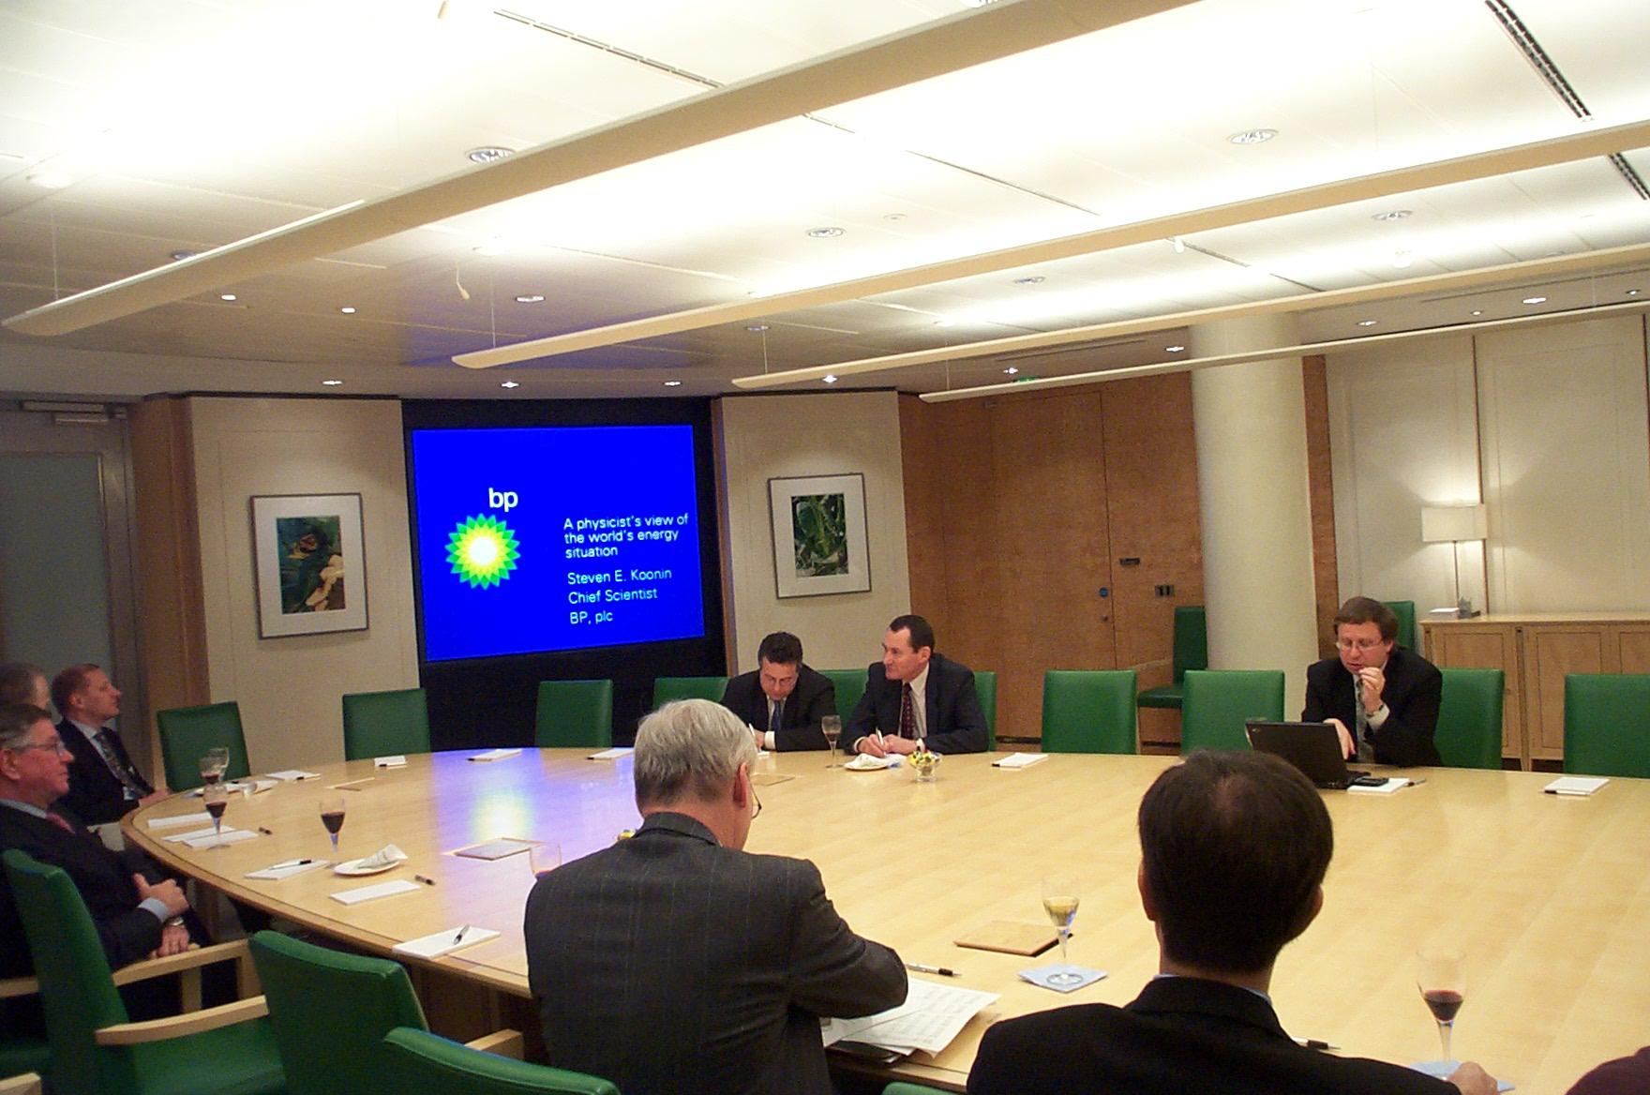
4 | Multimedia Applications
Examples of Multimedia Applications:
Residential services
Video-On-Demand
Video phone, A/V conferencing
Home shopping
Business services
Corporate education
E-Business
http://cis.k.hosei.ac.jp/~jianhua/course/mm/Lesson01.pdf
Notes:
Mention the fact that movie theaters used to be film and now everything is digital. This is osmehting that happened in my life time. This along with tape cassettes and CDs all the way to the iPOD

Slide 33
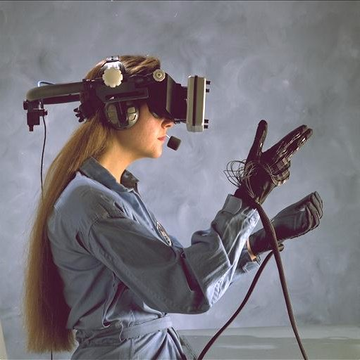
4 | Multimedia Applications
Examples of Multimedia Applications:
Education
Digital libraries
Distance learning
Science and technology
Virtual environments
Scientific visualization prototyping
http://cis.k.hosei.ac.jp/~jianhua/course/mm/Lesson01.pdf
Notes:
Mention the fact that movie theaters used to be film and now everything is digital. This is osmehting that happened in my life time. This along with tape cassettes and CDs all the way to the iPOD

Slide 34
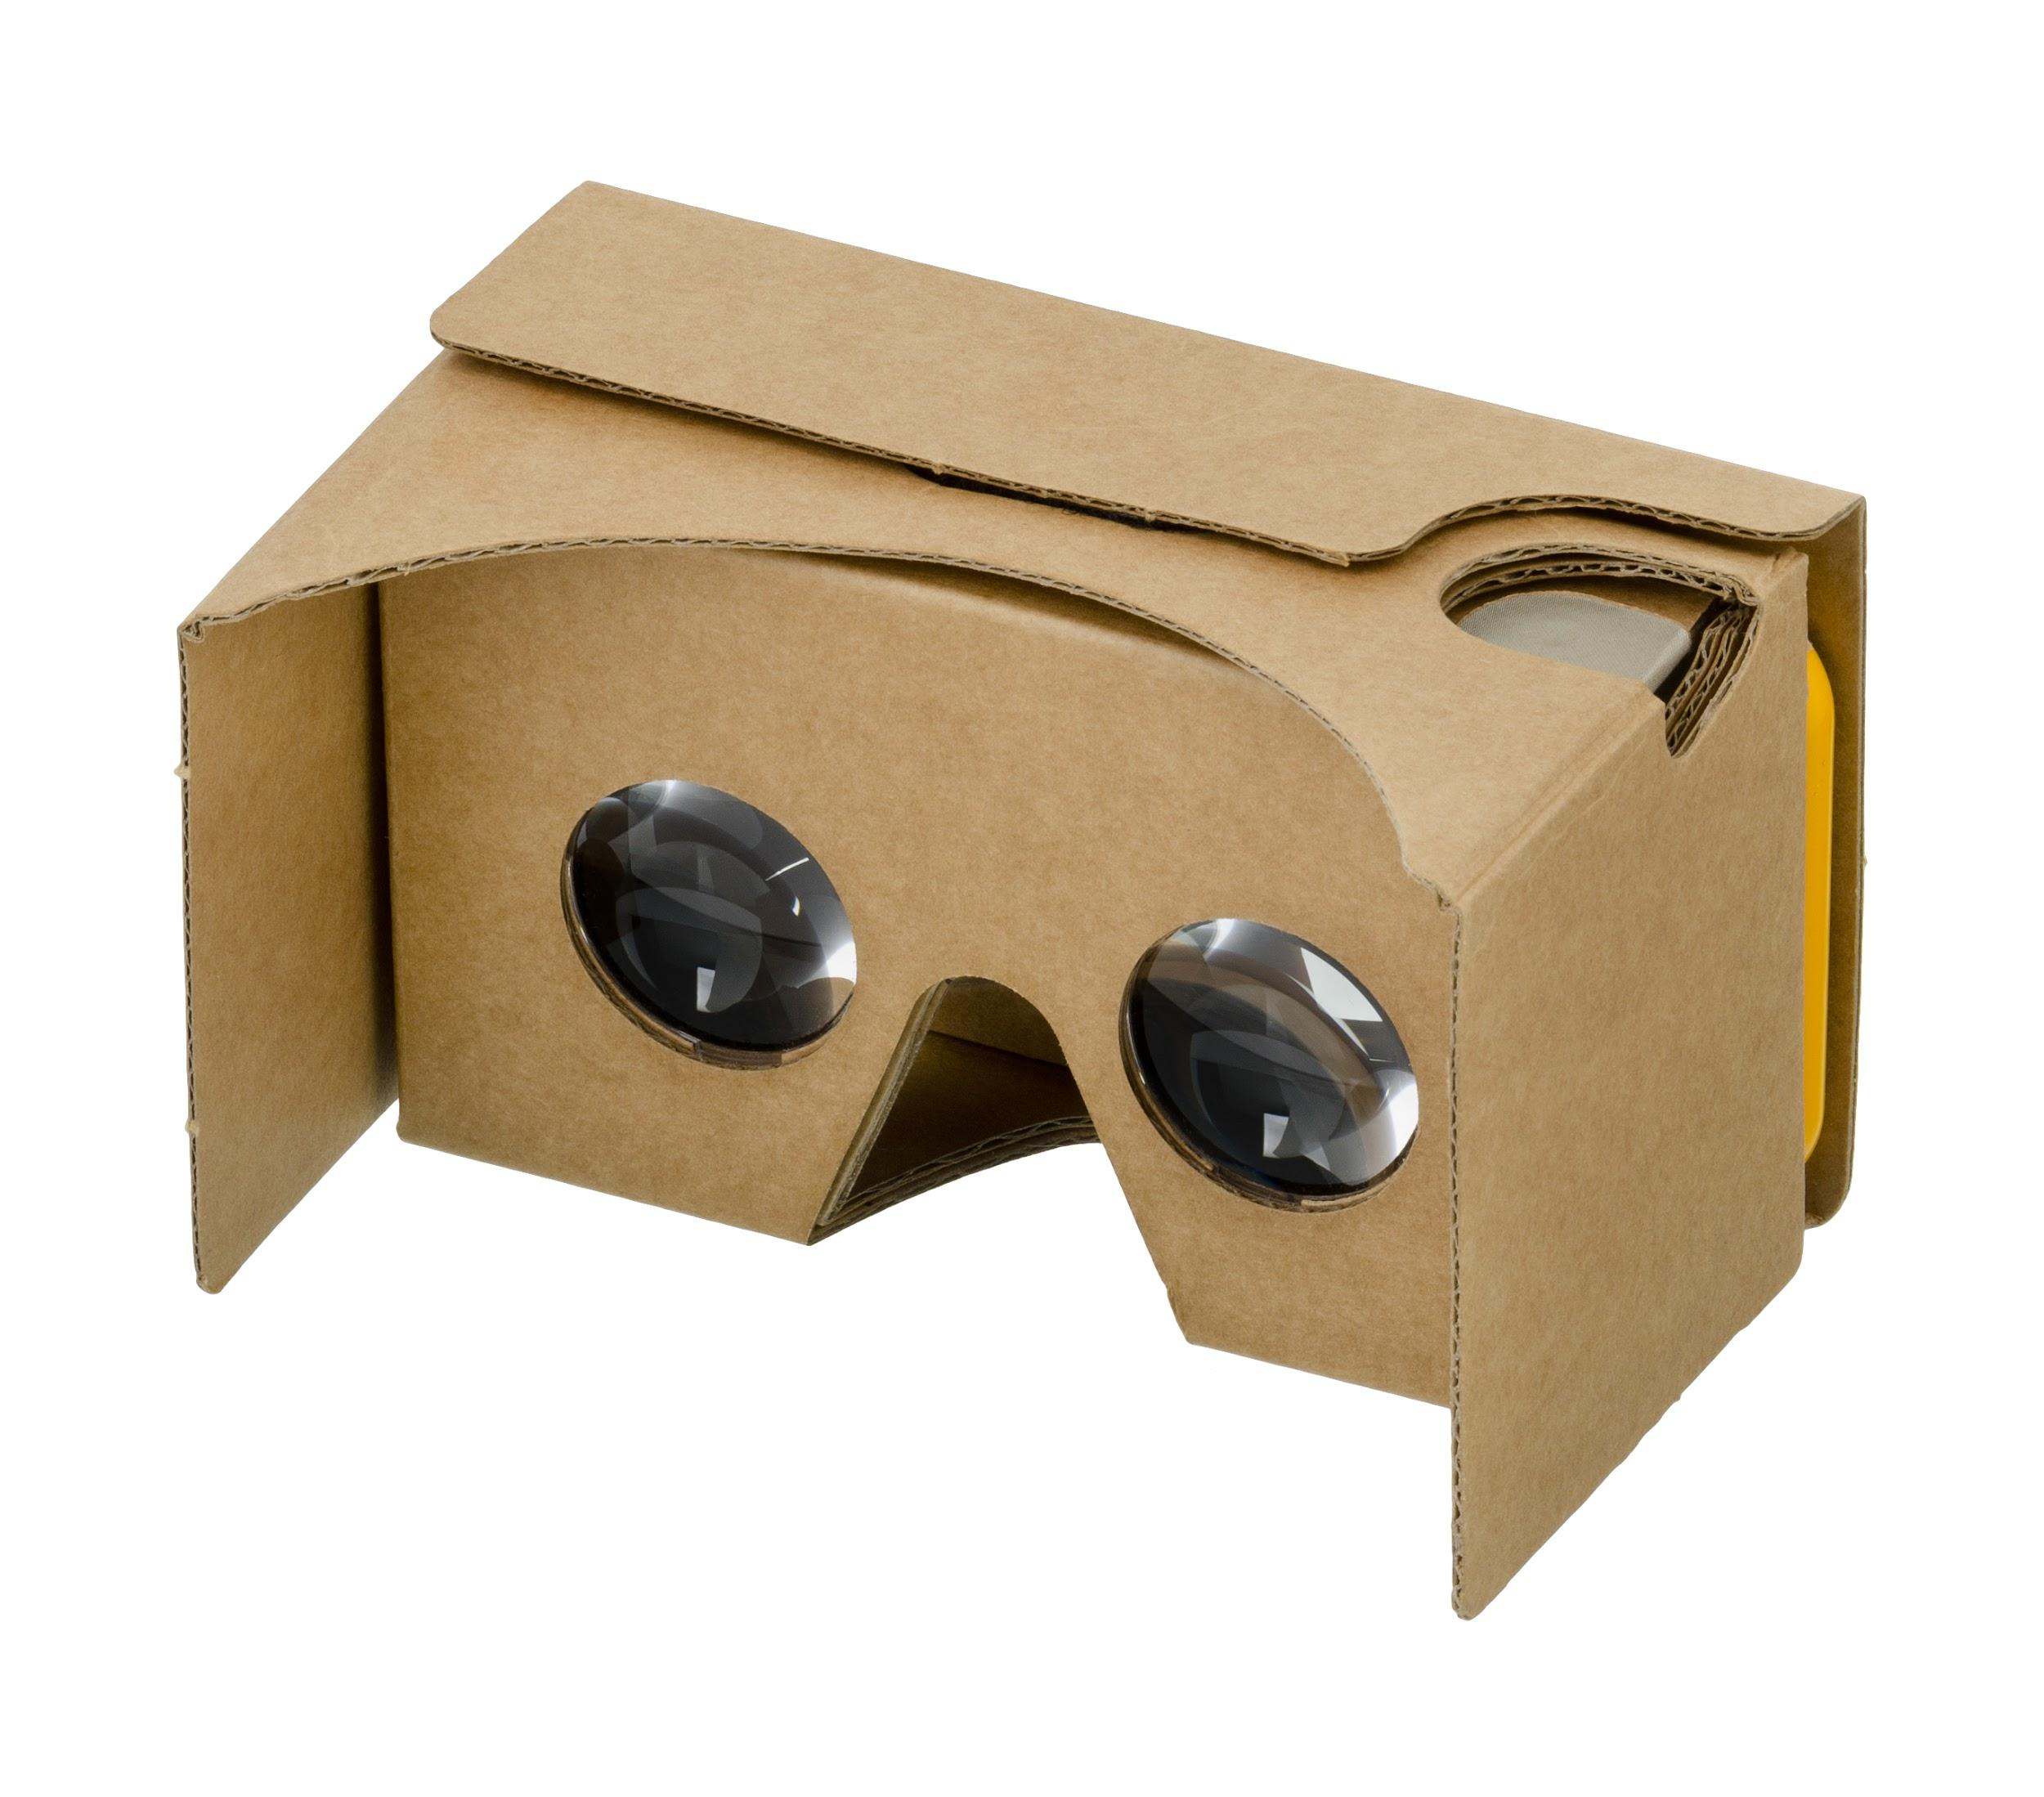
4 | Multimedia Applications
Examples of Multimedia Applications:
Entertainment
Games
Interactive TV
Post production of movie and music
Medical applications, Web applications and much more!
http://cis.k.hosei.ac.jp/~jianhua/course/mm/Lesson01.pdf
Notes:
Mention the fact that movie theaters used to be film and now everything is digital. This is osmehting that happened in my life time. This along with tape cassettes and CDs all the way to the iPOD

Slide 35
5 - Working with Libraries

Slide 36

5 | Working with Libraries
Man-made, often open sourced
Can create own libraries
no existing ones
existing ones unsatisfactory or don’t
suit needs
licensing issues
Simply download library and import for usage
Be sure to check permissions (licensing)

Slide 37
BREAK
Q:?
a).
b).
c).
d).
e).

Slide 38
Lesson 2 | Summary + A Look Back
1 - Multimedia Computing and Classification
2 - Multimedia Importance
3 - Driving Forces in Multimedia
4 - Multimedia Applications
5 - Working with Libraries

Slide 39
Lesson 3
Supplemental Material

Slide 40
Lesson 3 | Supplemental Material
1 - Android Multimedia
2 - C/C++
3 - Python

Slide 41
BREAK
Q:?
a).
b).
c).
d).
e).

Slide 42
1 - Android Multimedia

Slide 43
1 | Android Multimedia
MediaPlayer class
plays audio/video
uses local files or URIs/URLs as input
in other words: uses a local file or streams a file
decodes files to be played back
AudioManager class
allows change for audio focus
this is because there may be multiple sources trying to output audio (only one output audio stream)
http://developer.android.com/guide/topics/media/mediaplayer.html

Slide 44
BREAK
Q:?
a).
b).
c).
d).
e).

Slide 45
2 - C/C++

Slide 46
2 | C/C++
used to write programs using the NDK (for OpenCV)
C++ is simply C with classes
thus to similar to Java (barring syntax) but with memory management
powerful language, very popular in industry
Refreshers:
C++ is multi-paradigm (e.g. OOP, Procedural)
will be using objects/classes (the Java similarity) or structs
stack vs heap
portable -- fast -- old -- many libraries
Notes:
portable -- run on any system
fast -- no interpreter or VM or anything; just compile into machine code to run
old
many C/C++ libraries can be used in other programming languages

Slide 47
2 | C/C++
Remember the NDK?
Used to create Android applications with C/C++
Perfect for Computer Vision because OpenCV is a C++ library
will talk a ton more about OpenCV later
image processing
Check out Course 2 Module 7!
Setup, Application, Deployment
Notes:
c++ is multi-paradigm

Slide 48
BREAK
Q:?
a).
b).
c).
d).
e).

Slide 49
3 - Python

Slide 50

3 | Python
Highly readable, general purpose, simpler
scripting language
nice syntax (i.e. indentation)
dynamic type system
Supports multiple programming paradigms (object oriented, procedural, etc)
Tons of libraries available
SimpleCV or OpenCV
Documentation: https://www.python.org/doc/
Many teaching resources

Slide 51
Lesson 3 | Summary + A Look Back
1 - Android Multimedia
MediaPlayer
AudioManager
2 - C/C++
C/C++
NDK
3 - Python

